Slide 1

Negotiated Workplace Learning Week 7
Negotiation Skills
Sandra Okwara

Slide 2
Aims
Understanding Negotiation
The need for Negotiation Skills
Winning Negotiations
Preparing for Negotiations
Negotiating for a win win Solution

Slide 3
What is Negotiation ?
Negotiation is about two or more people findings ways to accept solutions to a mutual problem.
When negotiation is done successfully, all parties are satisfied
Successful Negotiation requires all parties to be willing to compromise
Roles and strategies need to be clarified in effective negotiation.

Slide 4
Factors to consider before Negotiations
Identify the goals : It is important to outline the goal of the negotiation and understand the goal of the other person in the negotiation.
Request: Identify what you may want to ask for in the negotiation process and identify what you will be prepared to give in to achieve a win-win solution
Alternative Goals ; Identifying your best alternative to a negotiated agreement ( BATNA) is important as it helps to secure your position with different options.
Previous Discussion : Consider how negotiation and discussion has been previously with the individual.
What consequences are there in the negation? What will the parties in the negation win or lose?

Slide 5
Factors to consider before Negotiations
Stakeholders Mapping : identify the person with the power in the negotiation and think about how this may affect the success of the negotiation.
Solution: Consider what may be a fair solution for both parties. This needs to be something you can suggest with confidence.

Slide 6
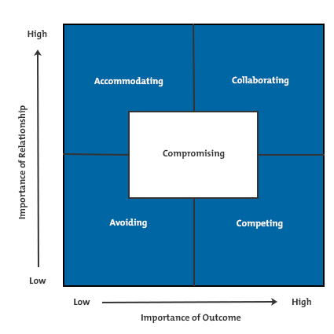
Choosing the Best Bargaining Strategy

Slide 7
Lewicki and Hiam's Negotiation Matrix
This model is used to identify the best option based on the situation of the individuals. It has Five negotiation Strategies. It also considers the importance of the negotiation outcome to the individuals.
Avoiding
Competing
Accommodating
Collaborating
Compromising

Slide 8
Avoiding
The "Avoiding" strategy appears in the lower left-hand corner of the matrix, and it represents situations where the outcome and the relationship are both low priority. Put simply, it's not worth getting into a conflict over this situation. So, you can either withdraw from negotiations (temporarily or permanently) or avoid the situation altogether.
This Strategy can be use when the other party is angry or emotional.

Slide 9
Accommodating (Lose to win )
The "Accommodating" strategy falls in the upper left corner of the matrix; when the relationship has high importance, but the outcome of the negotiation isn't a priority.
With this strategy, you're not too worried about "losing" on the outcome in order to preserve the relationship; for instance, when you're negotiating a raise with a star employee, who you really want to keep. It's also useful in situations where you need to delay a bigger negotiation until you have more support, evidence, or time.
Last, you can use accommodation to accept a short-term loss in exchange for a long-term gain. For example, you might accommodate your boss by delaying your vacation so that she can take hers, so that, in exchange, she gives you an extra two days off in the next month.

Slide 10
Competing (Win-Lose)
This strategy is shown in the lower right-hand corner of the matrix. Here, the outcome is important, while preserving the relationship may not be important at all. This strategy is best when you need to win, even at the expense of the relationship. A good example of the competitive strategy is when you buy a car; you want the best deal possible, and maintaining a friendly, lasting relationship with the salesperson isn't important.
You can use this strategy when you're negotiating with someone who represents someone else, or when both parties have only short-term goals.

Slide 11
Collaborating (Win-Win)
The "Collaborating" strategy makes up the upper right corner of the matrix. Collaboration is a win-win or integrative negotiation style, because the negotiation is important to win, at the same time that you preserve the relationship. Both parties need to achieve their goals in some way.
Collaboration is often the best approach when there are undesirable outcomes, such as two parties fighting over a very small reward. With collaboration, you can both work together to achieve a larger reward, instead of settling for even smaller pieces.
Start the collaborative negotiating style by displaying trust and building rapport . Tell the other party openly what you intend to do and what your goals are. By being open in this way, you'll build trust and create bonds.

Slide 12
Compromise (Split the Difference)
"Compromise" is located in the center of the matrix. Compromise is often sought when parties can't find ways to collaborate fully, but when they still want to meet their goals and preserve the relationship. Compromise requires less intentional effort than collaboration.
Compromise often uses strategies from the other four negotiation styles, which is why understanding the other styles will help you compromise more effectively.

Slide 13
Skills required for Negotiation
Assertiveness
Communication
Time management
Planning
Critical Thinking
Decision making
Problem Solving

Slide 14

Things to remember
Separate people from the problem
Focus on the Interest of the individuals not the positions
Suggest Options for Mutual Gain
Be objective
Know Your BATNA (Best Alternative To a Negotiated Agreement)

Slide 15
Review learning ?
What have we learnt
What changes will you make from now?

Slide 16
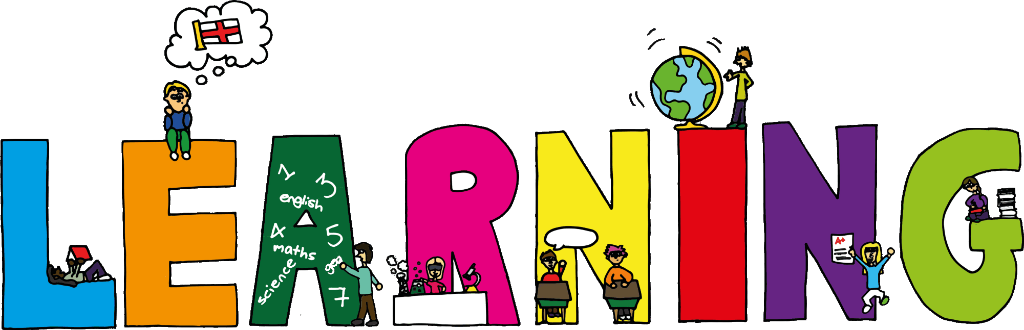
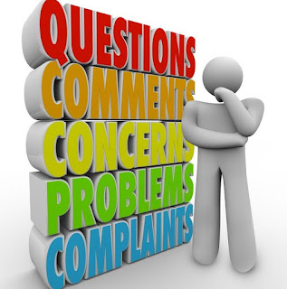
What have you Learnt?

